Slide 1
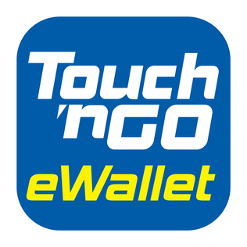

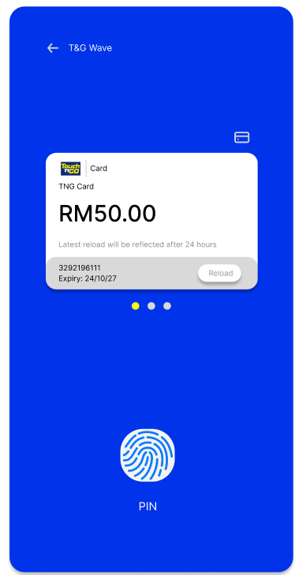
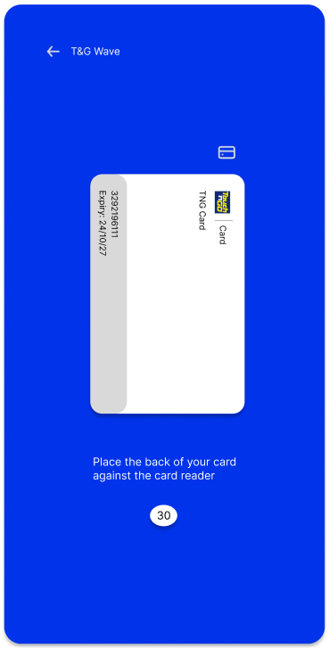
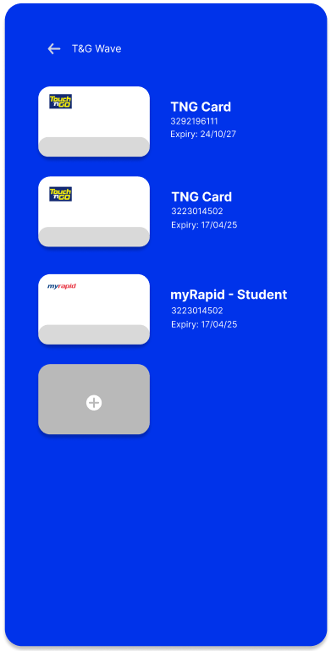
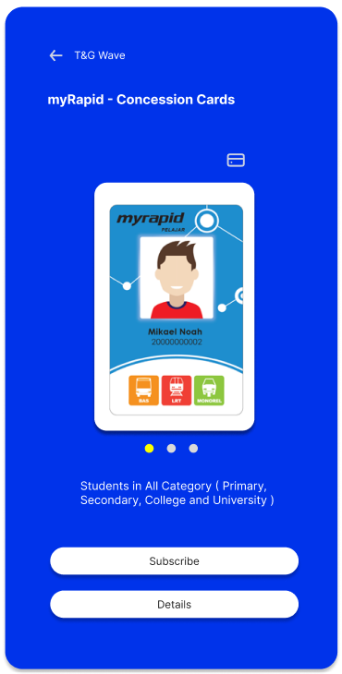
TNG Wave
Card access via fingerprint authentication or T&G Pin
3
Add TNG Card or any TNG Wave supported card
1
Place the device against the card reader to pay for the fare
4
Easy subscription for myRapid products and services
2

Slide 2
Problem Statement
The users need to top up the enhanced physical TNG card through NFC, only they are able to pay for the transport fare which involves a two-step process. The functionality of NFC is not fully utilized as it is used for top-up purposes only, but not for direct payment Besides, the hassle of registering and subscribing myrapid services takes long time to process and requires complex procedures.

Slide 3
Market/Consumer Needs
Abandon the need to own a physical card for payment
Subscribe to myrapid services through TNG applications
NFC for contactless payment on transport or transactions directly via mobile devices
Pay without internet connection

Slide 4
Value Proposition
Intermediary to store bank card details
Gain creators
Always “available” e-wallet
Pay without internet connection
Save time
Contactless payment for transport
NFC antenna
Auto-subscription of travel pass plan
Gains
E-wallet for daily transaction and transport
Eliminate the risk of losing card
Save the step of topping up card
Easy subscription of travel pass
Job-To-Be-Done
Make daily payment
Products & services
Myrapid services subscription
Subscription of travel pass through TNG app
Subscription of travel pass at physical counter
Link e-wallet to bank for direct usage
Pains
Hassle of unlocking phone & open barcode/QR for payment
Unable to pay when no internet connection available
Direct TNG Wave feature
Pain relievers

Slide 5
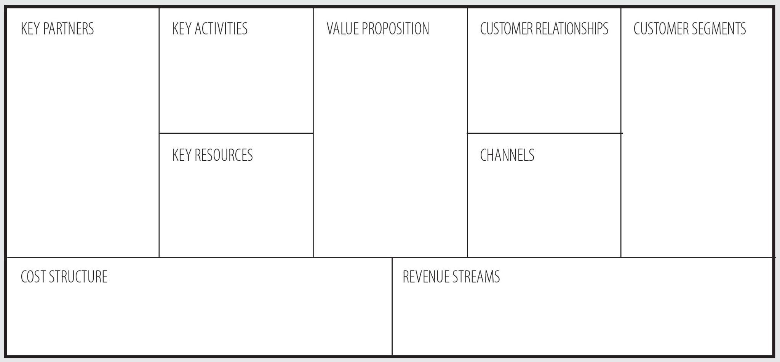
Business Model
Software Development and Maintenance
Contactless Payment
Bank
Contactless payment in daily purchase and transportation by tapping their phone
TNG E-Wallet user who uses NFC phone
Contact and each agreement with store to install NFC readers
Payment Gateway
IT company that make NFC software
Consumer who are willing to adopt the mobile banking system
Educating the Market to increase consumer base
Software Developer
Prasarana Malaysia (public transport operator)
Near-field communication (NFC) technology
TNG e-wallet app
TNG brand name
Payment Terminal
TNG E Wallet ’s existing user
Mobile Devices
NFC software and hardware development by IT company
Software Development and Maintenance
Platform Fee
Commission
Merchant Fee
Human Resources
Advertising and promotion

Slide 6
Closing Remarks
The Covid-19 pandemic has made contactless payment a new norm. At the point of sale, consumers have increasingly migrated toward no-touch payment via near-field communication (NFC) as it is more secure and convenient than a physical card. Thus, integrating NFC payment with a TNG e-wallet would be a good idea to allow the consumer to make payments without a physical wallet or credit/debit card.

